Slide 1
Basic Software Development Process Methodology Unit 1 – INTRODUCTION AND CONTINUITY
DD-MM-YY
PEG, KPIT Technologies

Slide 2

Continuity

Slide 3
The General Problem Solving Process
I’M HUNGRY
I WANT SOUP
COOK & EAT
SOUP
AM I HUNGRY?

Slide 4
Waterfall Process
REQUIREMENTS
DESIGN
CODE
TEST

Slide 5
V Process
REQ
FT
HLD
INT. T
LLD
UT
CODE

Slide 6

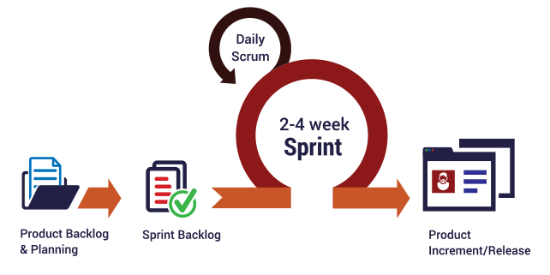
Iterative & Incremental Process
Requirements
Design
Scrum Model
Planning
Code & Test
Spiral Process Model

Slide 7
Goal of SDPM
What do all of the process models have in common?
Waterfall Process
Product to Product Continuity
Requirements to Design to Code
V Process
Product to Product Test Continuity
Requirement to Requirement Test, etc.
Iterative Process
Increment to Increment Continuity
Hence, Continuity is adopted as the principle & goal of SDPM.

Slide 8
Continuity Definition
Continuity
A process continuum capable of producing a continuous software product with verifiable process and product continuity.
Continuum - “A thing having a continuous structure.”
Continuous - “Uninterrupted, connected in space and time.”
Continuity - “The state of being continuous.”

Slide 9
Introduction to SDPM

Slide 10

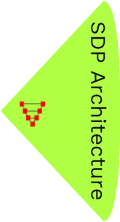
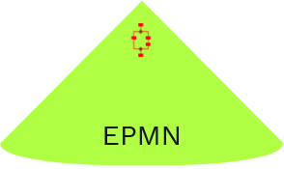
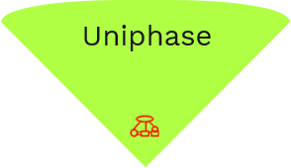
SDPM
Software Development Process Methodology (SDPM) is a proprietary methodology used by KPIT for all engineering product development and services. SDPM provides frameworks for projects to develop, plan and execute unique and specific processes suitable to individual needs.

Slide 11
Uniphase
Uniphase is a small manageable phase of a process. All Project’s engineering processes are created in terms of one or more Uniphase. Uniphase is used to uniformly identify all activities, information and actors that specify the definition of that small manageable phase i.e. Uniphase.
M&C
C
P
S

Slide 12
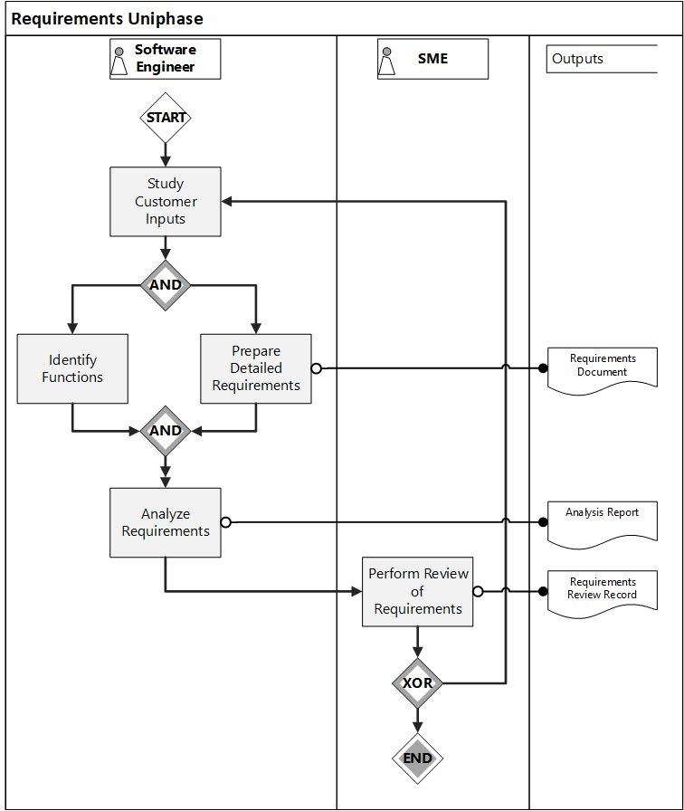
Process Element
Process (P) element describes the transformation activities of the Uniphase. Activities (and their relationships) which transforms an (a set of) input into an (a set of) output are defined in P element.
*Illustrative

Slide 13
Screen Element
Input
Business
Requirements
Screen (S) element describes the final verification & validation to be performed on outputs generated in P element. Screen element ensures the continuity between inputs and outputs.
Upstream
Continuity with Inputs
Traceability
Quality & CM
Conformance to Standard
Right Input
Product
Software
Requirement
Downstream
Fit for Use
Completeness
Next Product
Software
Design

Slide 14
Store Element
Store (C) element describes the configuration of the input and output work products.
Change Request
Defects (Unforced Change)
New Requirements (Forced Change)
M&C
Management & Control
C
Store
SRD
Business Requirements
P
Process
S
Screen
SRD
Defects
SRD V1.0
SRD V1.1
Business Requirements
/
Change Request
I/O/P/I | Name | Config ID | Source | Destination
I/-/-/- | Business Requirements | PRJRD DC 001 | Customer | Requirements
-/O/-/- | SRD | PRJRD DC 002 | Requirements | Design
Typical Store Definition

Slide 15
Management & Control
Management & Control (M&C) element describes the governance and oversight to be followed during the implementation of the Uniphase.
Management and Control
1500+ projects in the database
Process
Productivity
Quality
Stability
Process
Screen
Configuration
Historical Data
Data
Work Effort
Discontinuity Found
Forced Changes
Plan
Rework Effort
Discontinuity Escaped
Unforced Changes
Magnitude
Defect Type
Information
Schedule Variance
Change
PAR Meeting (WSR)
Analysis
Status Meeting (MSR)
MLRs
Metrics based Decisions - Closed Loop Feedback System

Slide 16
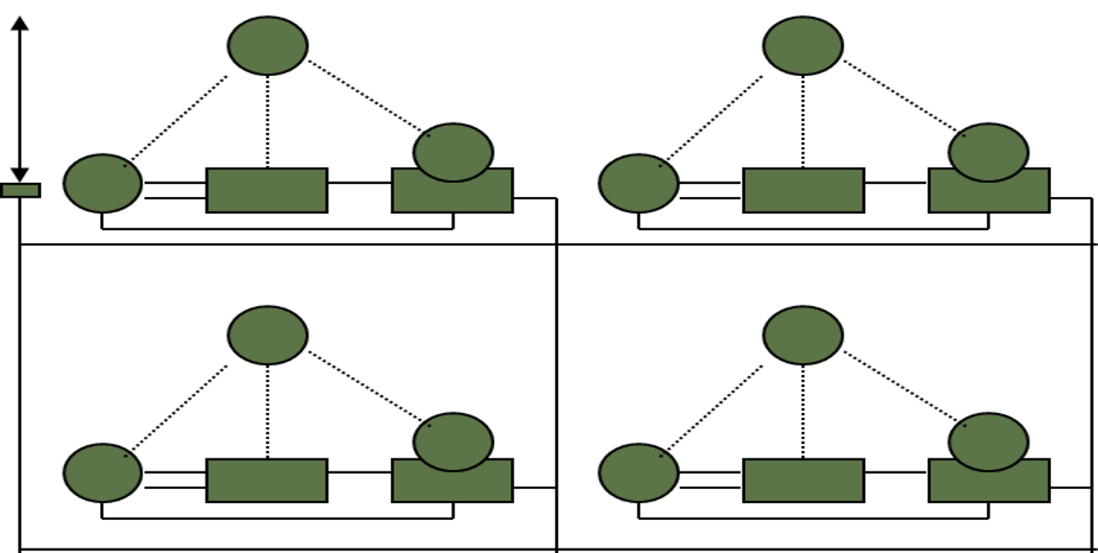
SDP Architecture
Software Development Process (SDP) Architecture allows to connect more than one Uniphase to define a data flow in the process. Using this data flow of the SDP Architecture; project specific process life cycle can be created, by adopting one or more life cycle models like Waterfall model, V Model, Agile, etc.

Slide 17
SDP Architecture - Example
Store (C) element of every Uniphase can be connected with every other Uniphase to describe the data flow of the SDP Architecture.
M&C
C
P
S
M&C
Requirements
M&C
C
C
P
S
P
S
Testing
Design
M&C
C
P
S
Coding
An exemplar SDP Architecture is created by adopting Waterfall model and V model to describe a specific process life cycle.

Slide 18
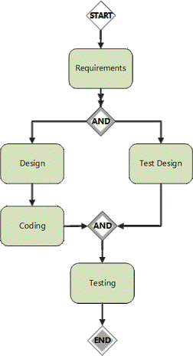
EPMN
Engineering Process Modelling Notation (EPMN) allows to specify/define the specific process, including the sequence of execution (of activities). Using EPMN, control flow and data flow within and between Uniphase is specified to complete the definition of specific process life cycle.
Between Uniphase
Within a Uniphase

Slide 19

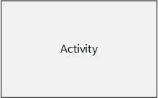
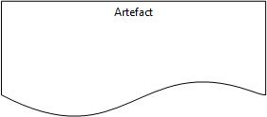
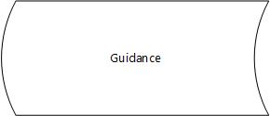



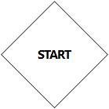
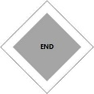
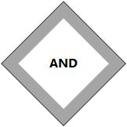
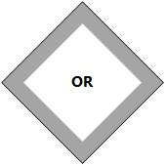
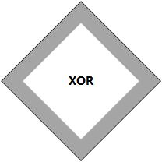
EPMN Shapes
EPMN models are created using shapes described below:
Uniphase
Activity
Artefact
Guidance
Role
Note
Lane
Start
Gate
End
Gate
AND
Gate
OR
Gate
XOR
Gate
Control Flow
Data Flow
RASIC Flow
These shapes are defined in detail in Getting Started->SDPM

Slide 20
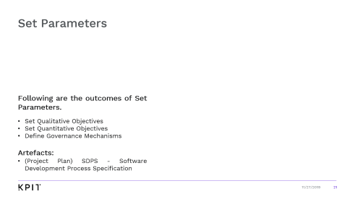
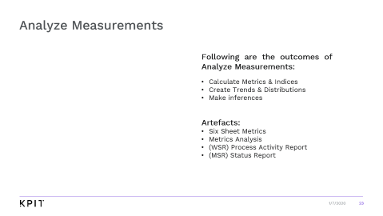
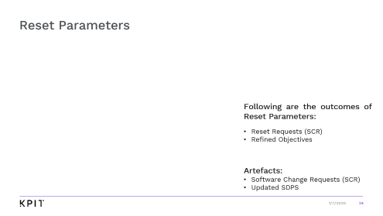

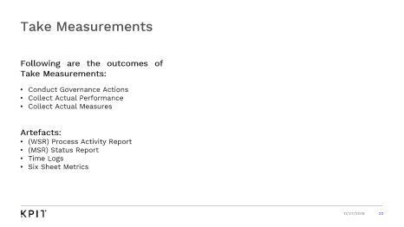



STAR Process
SET
Set-Take-Analyze-Reset (STAR) allows to monitor and control the execution of Uniphase (and whole process) as a closed loop feedback system. STAR is the dynamic element of the SDPM which is applied to execute the specific process as a project.
RESET
ANALYZE
TAKE

Slide 21
Set Parameters
Following are the outcomes of Set Parameters.
Set Qualitative Objectives
Set Quantitative Objectives
Define Governance Mechanisms
Artefacts:
(Project Plan) SDPS - Software Development Process Specification

Slide 22
Take Measurements
Following are the outcomes of Take Measurements:
Conduct Governance Actions
Collect Actual Performance
Collect Actual Measures
Artefacts:
(WSR) Process Activity Report
(MSR) Status Report
Time Logs
Six Sheet Metrics

Slide 23
Analyze Measurements
Following are the outcomes of Analyze Measurements:
Calculate Metrics & Indices
Create Trends & Distributions
Make inferences
Artefacts:
Six Sheet Metrics
Metrics Analysis
(WSR) Process Activity Report
(MSR) Status Report

Slide 24
Reset Parameters
Following are the outcomes of Reset Parameters:
Reset Requests (SCR)
Refined Objectives
Artefacts:
Software Change Requests (SCR)
Updated SDPS

Slide 25

Delivery Excellence Group

Slide 26
Organizational Inter-Operability
Software
Development
Team
ECODE
C
u
s
t
o
m
e
r
HR
FLM
TAG
Process
Excellence
Group
Operations

Slide 27
Essential Information
Portal/Tool | Description
SDPM | https://sdpm.kpit.com Defines the Quality Management System of KPIT, contain the process library, including all templates, guidelines, checklists, etc.
URL (Projects History) | https://kpitc.sharepoint.com/sites/Auto_Repository Useful Resource Library – Contain the repository of all KPIT’s project’s data (shareable). Including SDPS, Lessons Learnt, Postmortems, Metrics, etc.
UNIPRO | https://unipro.kpit.com Project Planning, Tracking and Process Management Tool. Change Management, Reviews & Screens are automated using Unipro.
DRONA | https://drona-kel.kpit.com Tool used to manage Customer Feedback.
KAP | https://kap.kpit.com/redmine/ Agile projects planning and implementation are tracked through KAP tool.

Slide 28

Thank You

